Slide 1
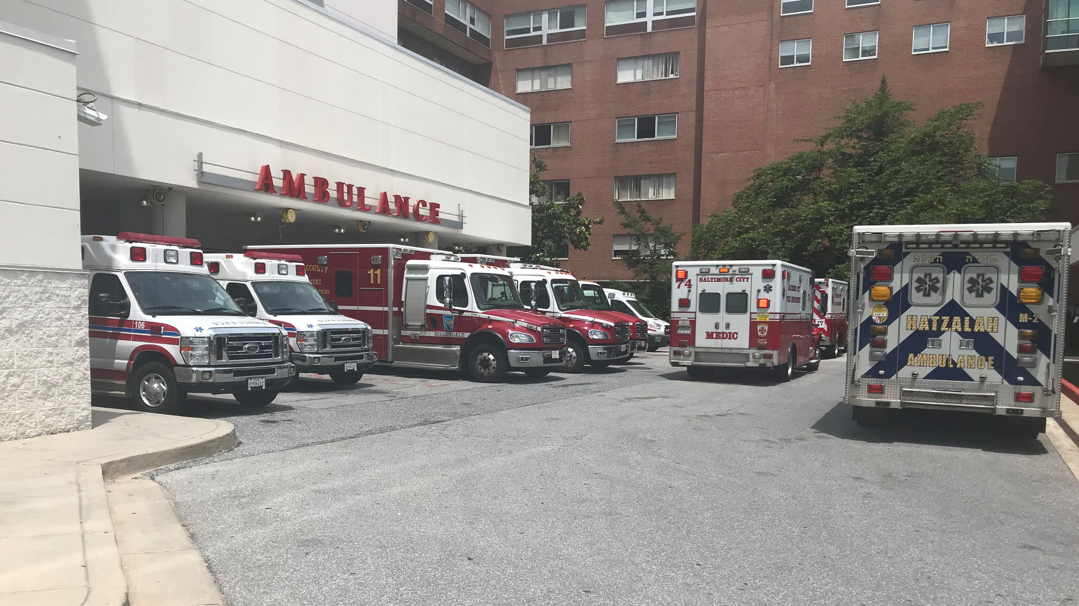
Save The Date September 27, 2021 Held Virtually and brought to you by Sinai Hospital Baltimore, Md
Treating Trauma:
Care Across the Continuum

