Slide 1
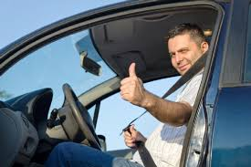
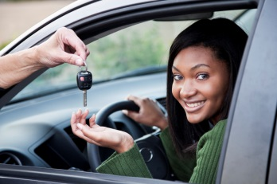
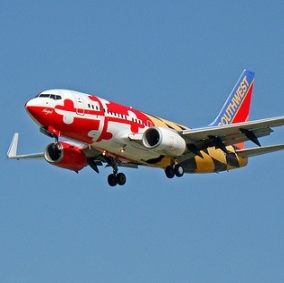
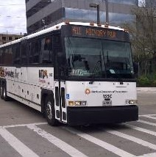
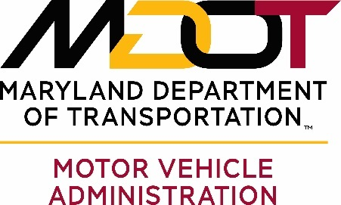
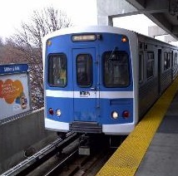
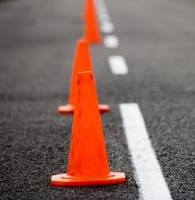
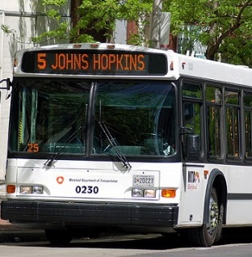
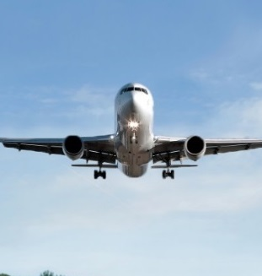
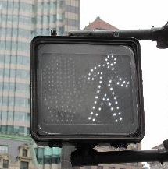
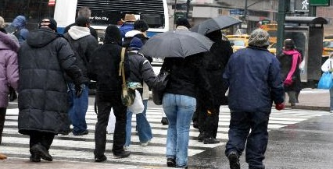
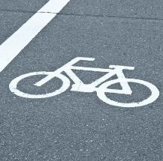
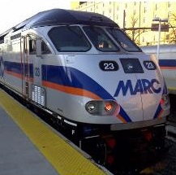
Transportation Solutions to Connect Our Customers to Life’s Opportunities
Trauma Net

Slide 2
Historical Trends
Traffic Fatalities on MD Roads
1960 – 2016
872 1968
Price of Gas
830
1987
Strategic Highway Safety Plans
AirBags
Helmet Laws
Auto & Highway Engineer.
521 / 522 2015 / 2016
GDL Laws
Tougher DUI Laws
Primary Belt Laws
2014: Lowest Since 1948

Slide 3
Our Collective Efforts
Save Lives!!
During the past decade Maryland has experienced significant decreases in Highway Fatal and Serious Injuries

Slide 4
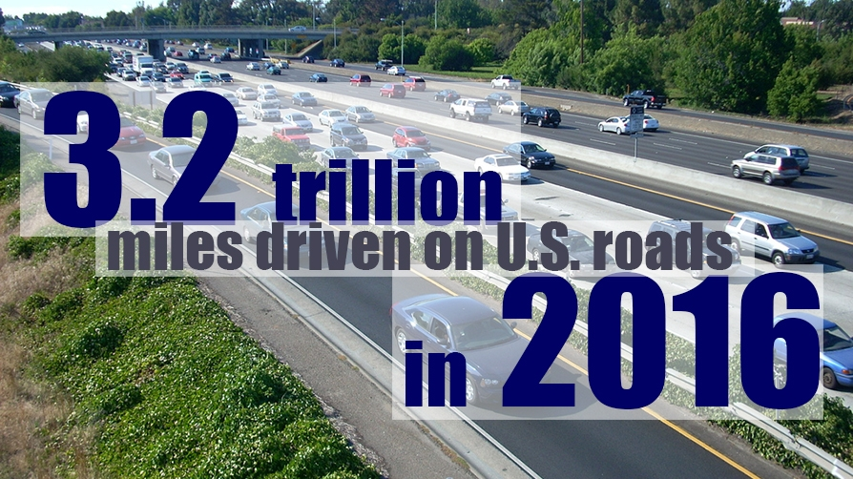
Increased Exposure
Maryland VMT:
2016: 2.9% from 2014
2017:  1.9% from 2015
Almost 4 BILLION
VMT more than 2014

Slide 5
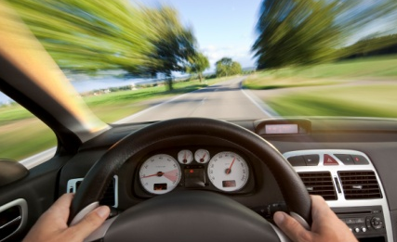
Maryland Motor Vehicle Occupant Fatality Causes
Unbelted = 530
(30% of all fatalities)
1,763 motor vehicle occupant deaths
for the period
2012-2016
(non-pedestrian and non-motorcycle).
Fifty-eight percent (n=1,021) involved speeding, impairment, or
lack of belt use.
MD’s Observed Belt Use Rate…
%
92.1
212
63
183
72
154
72
265
Speed = 361
(20% of all)
Impaired = 592
(34% of all)
5 yr Totals
Impairment is alcohol and/or drugs
Created by STAR-ORC NSC CODES

Slide 6
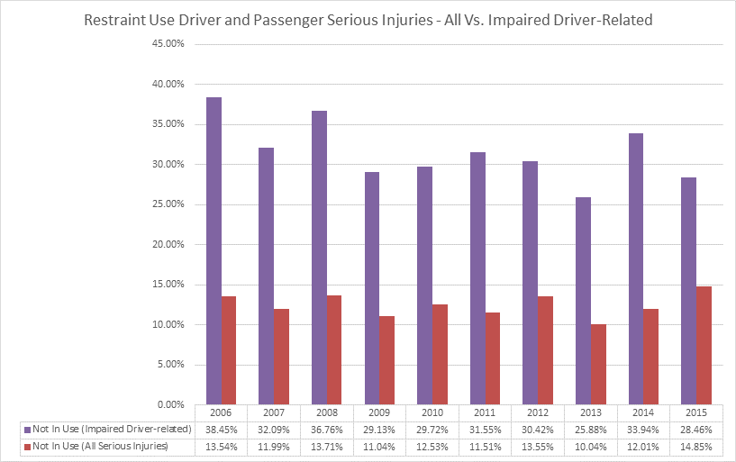
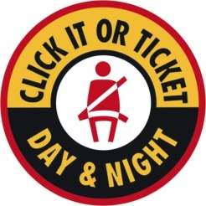
Unrestrained Serious Injuries Percentage of All vs Impaired Driving 2006-2015
91.1%
90.7%
92.1%
92.9%
2017 Observed SeatBelt Use Rate:
92.1%
Observed SeatBelt Use:
2012
2013
2014
2015

Slide 7
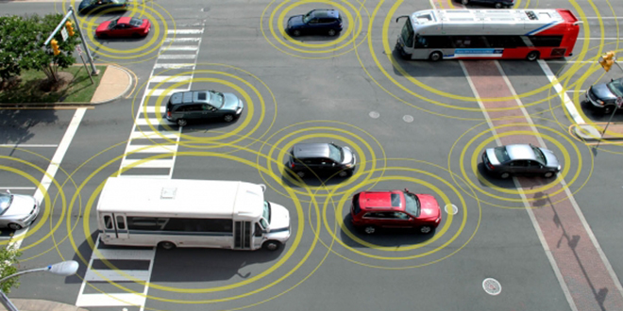
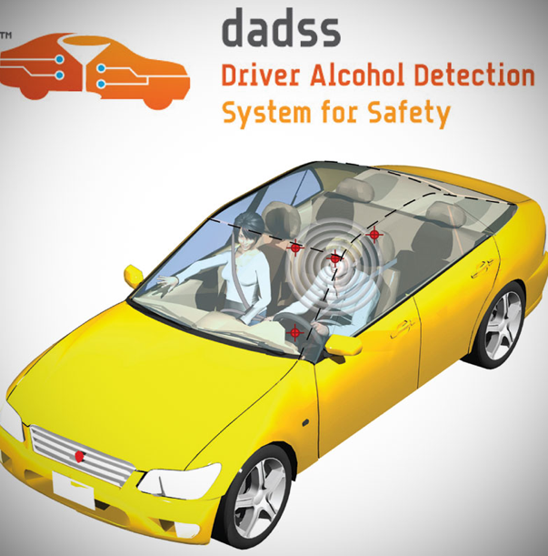
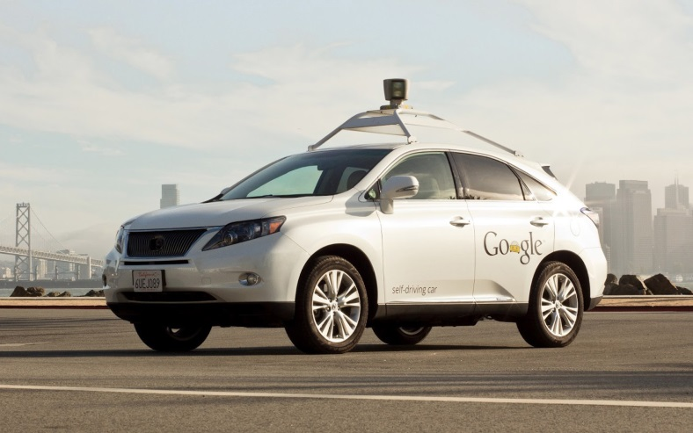
What Will History’s Next Chapter Look Like?
Crossroad: Intersection of Technology & Driver Behavior ….

Slide 8
Working Toward Zero Deaths

Slide 9
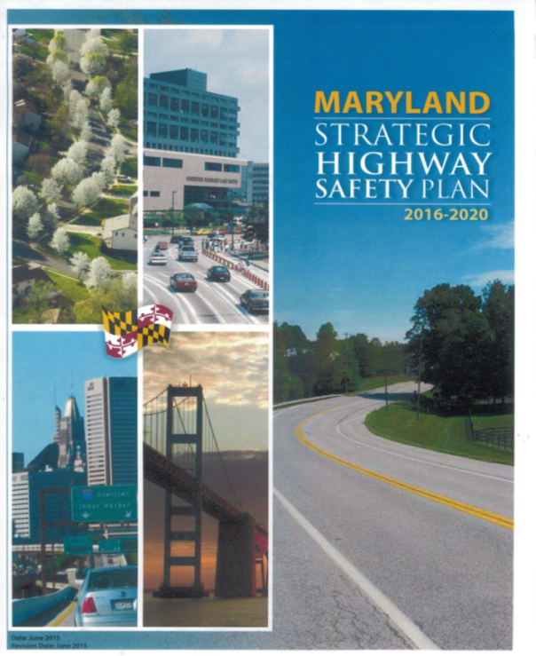
How do We Reverse the Deadly Highway Trend and Move Toward Zero Deaths?
STEP #1
Strategic Vision:
Toward Zero Deaths
Goal Statements
& Performance Measures

Slide 10
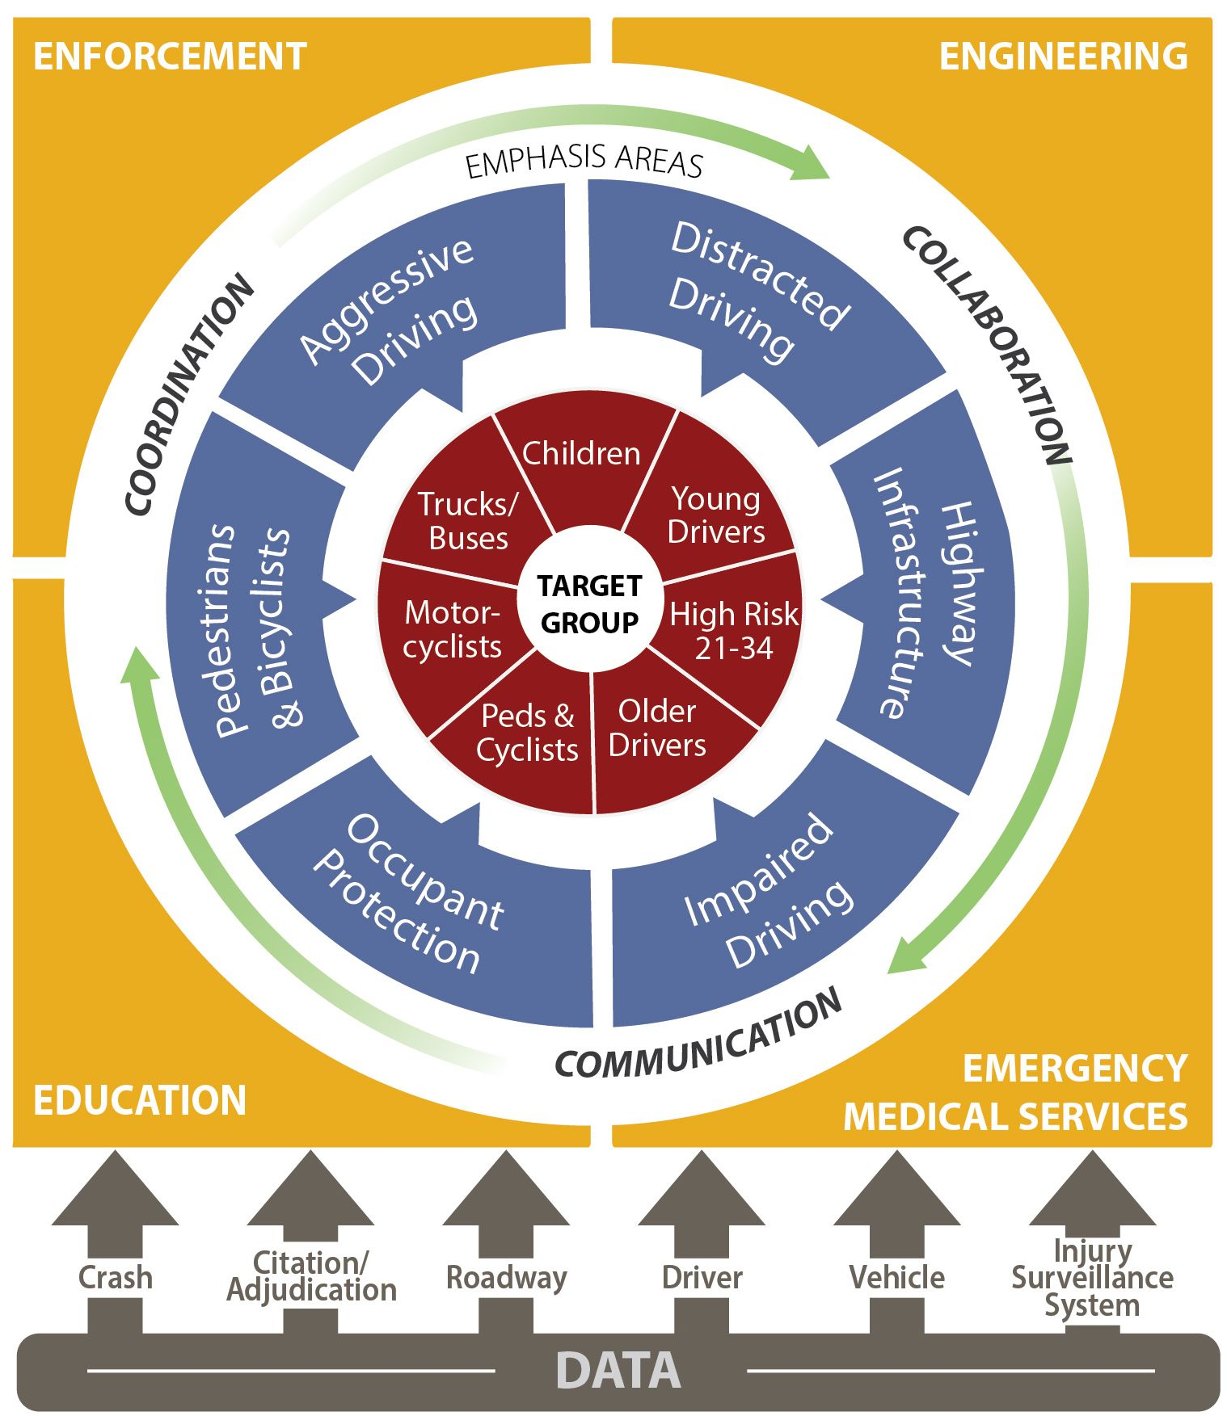
Maryland’s Path Forward

Slide 11
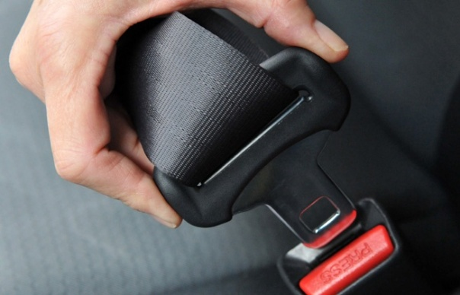
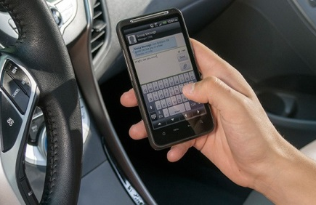
How do We Reverse the Deadly Highway Trend and Move Toward Zero Deaths?
Addressing Risky Behaviors
Aggressive Driving / Speeding
Distracted Driving
Occupant Protection
Impaired Driving
STEP #2

Slide 12
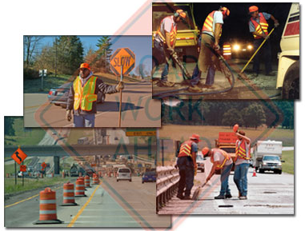
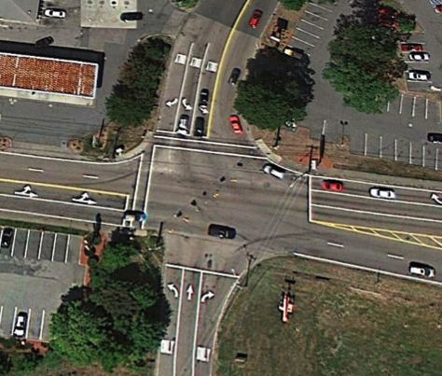
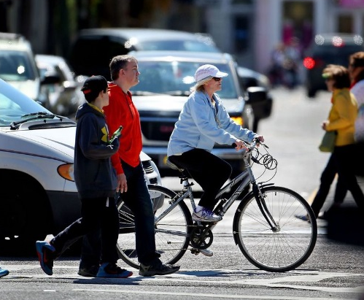
How do We Reverse the Deadly Highway Trend and Move Toward Zero Deaths?
Engineering Considerations
Run-Off-Road
Intersection Safety
Work Zones
STEP #2
Pedestrian & Bicycle Safety

Slide 13
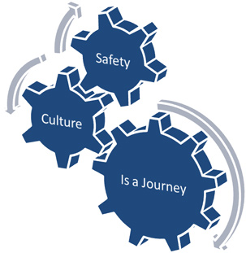
How do We Reverse the Deadly Highway Trend and Move Toward Zero Deaths?
Creating a Safety Culture
STEP #3
So, What’s Culture?
An examination from:
Personal Perspective
Community Perspective

Slide 14
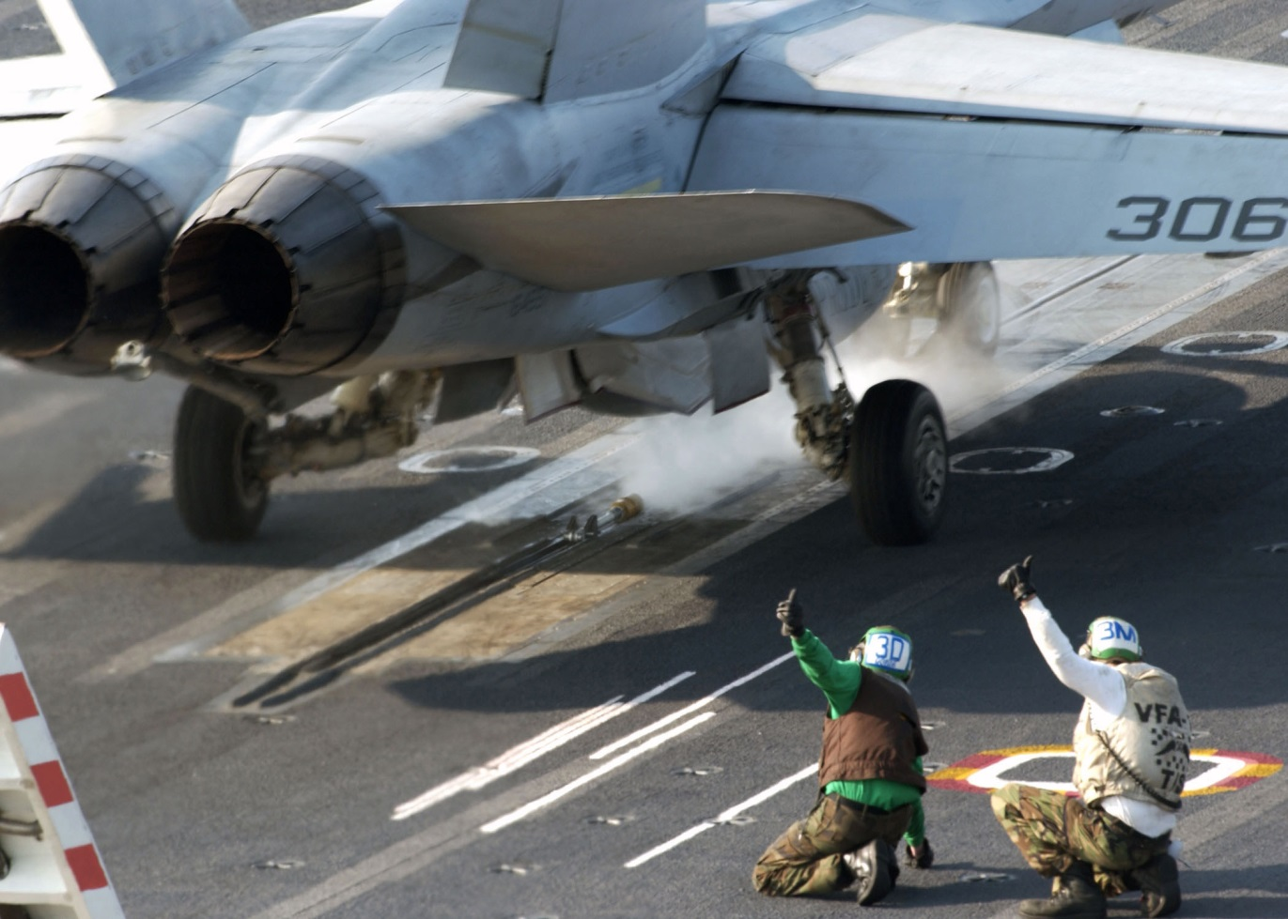
Safety Culture – A Personal Contribution
An Unforgiving Place!
Culture
It’s What We Do Around Here!

Slide 15
Creates a Culture of Safety … From the Start
The Driver Still Remains the Vehicle’s Most Important Safety Feature!
Driver
Seat Belt
Booster Seat
Forward-facing
Rear-facing
www.mdkiss.org
www.miemss.org

Slide 16
Safety Culture – A Community Effort
SAFETY PLANNING:
Locally Developed
& Locally Owned
What’s in your Community’s Plan ?

Slide 17
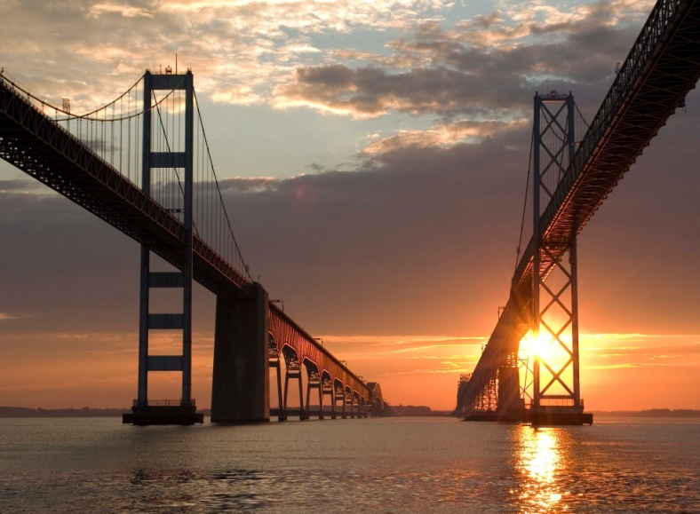
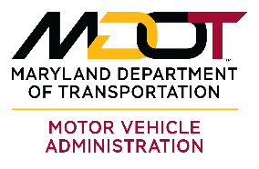
JOIN the JOURNEY
Thomas J. Gianni
410-787-4014
tgianni@mdot.state.md.us

